Slide 1
TITANIC DATA SET
DATE:24th December 2021
Group members : Arbazuddin
Anwar
Nihal Hussain
Notes:
We designed this template so that each member of the project team has a set of slides with its own theme. Members, here’s how you add a new slide to just your set:
Mark where you want to add the slide: Select an existing one in the Thumbnails pane, click the New Slide button, then choose a layout. The new slide gets the same theme as the other slides in your set.
Careful! Don’t annoy your fellow presenters by accidentally changing their themes. That can happen if you choose a different theme from the Design tab, which changes all of the slides in the presentation to that look.

Slide 2
OVERVIEW
Project Description
Dataset
Exploratory Data Analysis
Data Pre Processing
Data Visualization
Conclusion

Slide 3
Project Description
To predict whether a particular person is survived or not using data points given in the titanic data set.

Slide 4
Dataset
Titanic dataset consists of 891 rows and 12 columns which is obtained by ‘shape’ method.
Dataset consists of passenger id, no. of persons survived, class of tickets(Pclass), name of passengers, gender(sex), age, cabin etc.
Survived column has 0 and 1 values such that 0 means not survived and 1 means survived.
The method ‘count’ can be used on any column to display that particular column and also the values given to it.

Slide 5
Exploring Data Analysis
We observe that there are null values in some columns.
In ‘Age’ column 177 null values are present, in ‘Cabin’ 687 and in ‘Embarked’ column 2 null values are present. These can be identified by using “isnull” method.
Large percentage of null values/Missing data creates imbalanced observations, cause biased estimates and can even lead to invalid conclusion.

Slide 6
Data Pre Processing
To get rid of the null values. You have two options:
- You can remove all null values
- Handle the null values smartly
As there are many null values in ‘Cabin’ column, we are droping the column by using ‘drop’ method.
The null values in ‘Age’ column are then filled by the mean of all Age values in the column by ‘fillna’ method followed by ‘mean’ method.
Removing null values from the dataset is one of the important steps in data wrangling.

Slide 7
Data Pre Processing
These null values adversely affect the performance and accuracy of any machine learning algorithm.
So, it is very important to remove null values from the dataset before applying any machine learning algorithm.

Slide 8
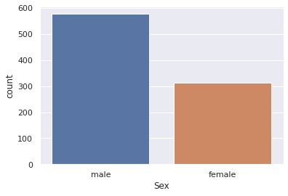
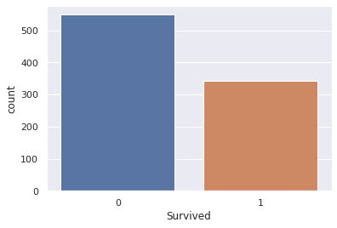
Data Visualization
Beside bar graph shows the count plot of ‘Sex’ column that is the count of male and female was there in the titanic.
Below bar graph shows the Count plot of survival of the persons in the ship where ‘1’ represents ‘Survived’ and ‘0’ represents ‘Not Survived’.

Slide 9
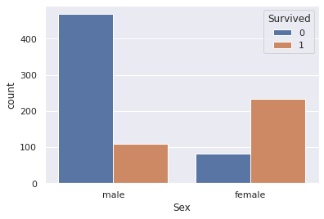
Data Visualization
The bar graph shows the separate count of male and female who are survived and not survived.
Majority of males are not survived and majority of females were survived as the population of males were more than females in the ship.

Slide 10
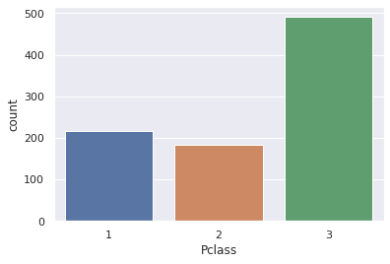
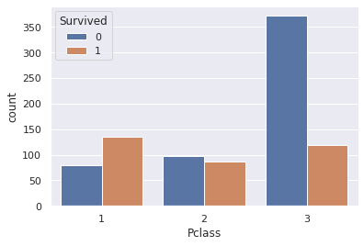
Data Visualization
Count plot of class of ticket where there were more third class ticket holders.
Below bar graph displays the count of survived and not survived passengers in each class

Slide 11
Conclusion
The purpose of titanic dataset is to use the existing features of passengers onboard titanic as predictors to predict their survival outcome, for 0 being dead and 1 being survived from the tragic ship crash.

Slide 12
Thank You

